Slide 1

Promises & Generators in ES6
Francis Dougherty Paulin
@paulin_francis
1

Slide 2

Who Am I?
@paulin_francis
2
Notes:
Senior consultant at Webstep Fokus
Full stack, but more and more interested in front end the last years
Ride my bike in my spare time

Slide 3
The JS Event Loop
Stack
callback queue
function logAsync(msg){
setTimeout(function theCallback(){
console.log(msg);
});
}
logAsync('hello world');
setTimeout
console.log
logAsync
theCallback
3
Notes:
This talk is about promises and generators, but to make sure we are all on the same page, I’d like to quickly though the event loop in JS
The important thing to take away form the demo is that the sync functions are long gone when the async functions are run by the event loop
push logAsync onto the stack
callback is enqueued to the callback queue
logAsync completes and the result is popped from the stack
the stack is now empty and the event loop dequeues callback from the jobs queue and pushes it to the stack for execution
callback is run and the result is popped from the stack

Slide 4
Problems With Callbacks
Only one interested party can “listen”
Pass responsibility to third party for running the callback(s)
Optional (if at all) error callbacks
Our brains read sequentially
4
Notes:
No control how many times (if at all) a third party runs your callback (too early, too late, multiple times, not at all)
What parameters does the third party actually pass?
Are exceptions swallowed?
Error first pattern can help, but ugly and not intuitive to think about error first. Introduce possibility of BOTH callback being called and the same issues as over apply
Can be hard to have a mental model of the execution of the code

Slide 5
Callback nesting
function myAsyncFunc(doneCallback){
fooAsyncFunc(function(fooResult){
barAsyncFunc(fooResult, function(barResult){
bazAyncFunc(barResult, function(bazResult){
quxAsyncFunc(bazResult, function(quxResult){
if(quxResult.foo === 'bar'){
doneCallback(quxResult, fooResult);
}
else {
doneCallback(barResult, fooResult);
}
});
});
});
});
}
function doStuff(stuff, moreStuff){
//Does something...
}
myAsyncFunc(doStuff);
5
Notes:
What is the problem?
readability and aesthetics
Super large gotcha if one or more of the functions aren’t async, then the program flow will be different, because the function will be pushed onto the stack immediately for execution
“Don’t release Zalgo”, always call callback async, otherwise all hell can break loose e.g.
function foo(result){
console.log(result);
}
var a = 0;
maybeAsync(foo);
a++;

Slide 6
Exception Handling
function myAsyncFunc(doneCallback, errorCallback){
try{
fooAsyncFunc(function(fooResult){
barAsyncFunc(fooResult, function(barResult){
bazAyncFunc(barResult, function(bazResult){
quxAsyncFunc(bazResult, function(quxResult){
if(quxResult.foo === 'bar'){
doneCallback(quxResult, fooResult);
}
else {
doneCallback(barResult, fooResult);
}
});
});
});
});
} catch(e) {
errorCallback(e);
}
}
6
Notes:
What are we actually catching here? Remember the event loop (this example is why we had to start with it)!
Will not work because unless the error is thrown in fooAsyncFunc, the function will be long gone….
Problem: You can simply omit the error callback, thus not handling errors anyway, or change the order

Slide 7
function myAsyncFunc(doneCallback, errorCallback){
try{
fooAsyncFunc(function(fooResult){
try{
barAsyncFunc(fooResult, function(barResult){
try{
bazAyncFunc(barResult, function(bazResult){
try{
quxAsyncFunc(bazResult, function(quxResult){
if(quxResult.foo === 'bar'){
doneCallback(quxResult, fooResult);
}
else {
doneCallback(barResult, fooResult);
}
});
} catch(e){
errorCallback(e);
}
});
} catch(e){
errorCallback(e);
}
});
} catch(e){
errorCallback(e);
}
});
} catch(e){
errorCallback(e);
}
}
7

Slide 8
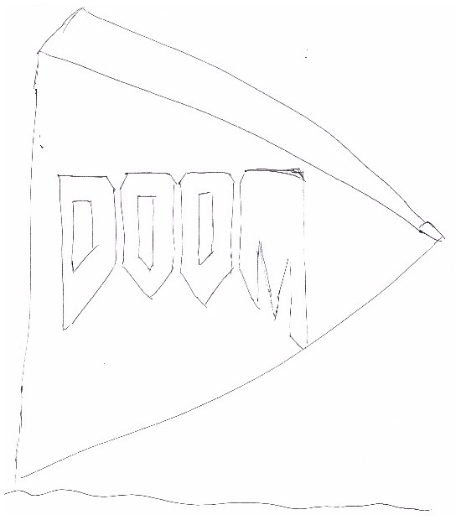

8
Notes:
We have created a “pyramid of doom”

Slide 9

function myAsyncFunc(doneCallback, errorCallback){
try{
fooAsyncFunc(function(fooResult){
try{
barAsyncFunc(fooResult, function(barResult){
try{
bazAyncFunc(barResult, function(bazResult){
try{
quxAsyncFunc(bazResult, function(quxResult){
if(quxResult.foo === 'bar'){
doneCallback(quxResult, fooResult);
}
else {
doneCallback(barResult, fooResult);
}
});
} catch(e){
errorCallback(e);
}
});
} catch(e){
errorCallback(e);
}
});
} catch(e){
errorCallback(e);
}
});
} catch(e){
errorCallback(e);
}
}
9
http://33.media.tumblr.com/tumblr_lt82s0D6Ar1qg39ewo1_500.gif

Slide 10
Promises To The Rescue
1. Order new bike online
2. Get receipt immediately (promise)
3a. Bike arrives :)
3b. Or bike gets lost in the post :(
10

Slide 11
Promise Basics
Provide standardised API for async programming
Promises are immutable
Returning within a promise yields a new promise; chaining
Resolving a promise with a promise, yields a new promise (not a promise of a promise)
11
Notes:
Three outcomes; never resolved, OK or error
Can create helper method to wrap regular callback functions into promise-aware functions

Slide 12
Promise States
pending: initial state, not fulfilled or rejected.
fulfilled: successful operation
rejected: failed operation.
settled: the Promise is either fulfilled or rejected, but not pending.
https://developer.mozilla.org/en/docs/Web/JavaScript/Reference/Global_Objects/Promise
12

Slide 13
Promise API
new Promise(function(resolve, reject) { ... })
Promise.resolve()
Promise.reject()
Promise.prototype.then(resolveFunction, rejectFunction)
Promise.prototype.catch(err)
Promise.all([])
Promise.race([])
https://developer.mozilla.org/en/docs/Web/JavaScript/Reference/Global_Objects/Promise
13
Notes:
Several promise libraries provide extra methods such as done and progress, but are not part of the spec.

Slide 14
Demo
14

Slide 15

Never Resolved Promises
Leveraging Promise.race()
15
https://media0.giphy.com/media/ayv7CprUwLq3m/200_s.gif

Slide 16
Demo
16

Slide 17
Exception Handling
Any error thrown inside a promise will implicitly reject the promise - this is a big deal!
Good practice to end chain with a .catch()
17
Notes:
second parameter / catch = the same
errors propagate through the promise chain
good practice to end with a catch, but not foolproof
try/catch won’t work out of the box, but we’ll get back to that and “fix” it

Slide 18
Demo
18

Slide 19
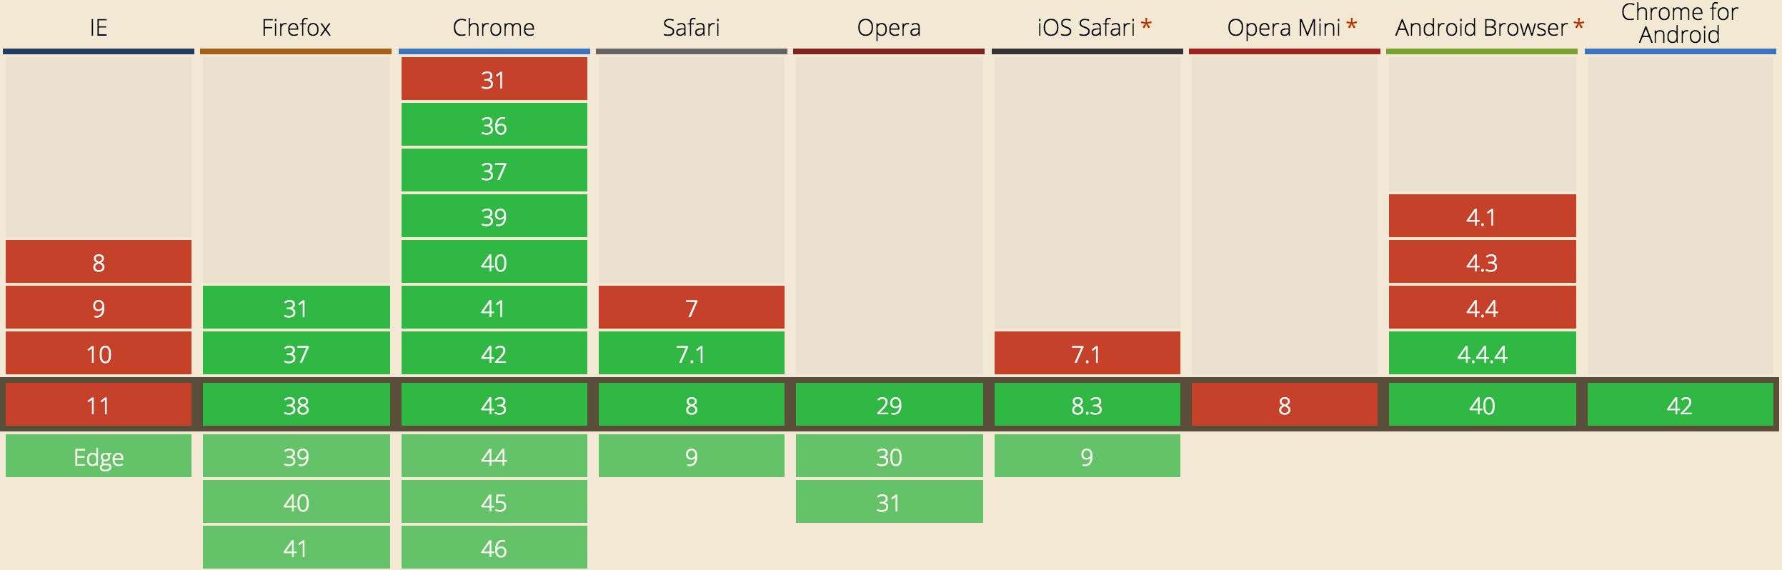
Using Promises Today
http://caniuse.com/#search=promise
19

Slide 20
Polyfills And Libraries
https://github.com/kriskowal/q
https://github.com/jakearchibald/es6-promise
https://github.com/cujojs/when
http://api.jquery.com/category/deferred-object/
20
Notes:
Because promises aren’t a language construct, they can be shimmed/polyfilled using setTimeout, or even better setImmediate.

Slide 21
Generators
A completely new flow control concept
Allow you to pause execution (lazy)
Can pass data two ways
Are not threads!
21
Notes:
Special functions that don’t have to run to completion immediately (if ever)
Can put the * after the function keyword or before the name function* foo vs. function *foo- no functional difference
the function invocation returns an iterator. call .next() to actually run the generator to the first yield
any args to the first yield are ignored (it’s just starting the generator after all)
To complete a generator’s iterator you can call myIterator.return(myReturnValue); The generator is terminated immediately, then myReturnValue is returned.
You can thow a spanner in the works of a generator by calling .throw() on the iterator. Experiment with this, as try/catch can now work with async stuff!!!
Generators are NOT threads, even though they can let you do weird shit that looks parallel at a glance
Apart from our use here, generators are useful for making lazy code that just computes the necessary item each time .next() is called instead of computing the entire range at once.
Demonstrate yielding Promise.All() inside an “ async runner”
Errors thrown from promises would normally get passed to .catch(), but a promise inside a generator is special, and the error is in fact thrown inside the generator, allowing us to use try catch inside the generator.
if you iterate using “for of” only yielded values are iterated over. The final “return value” is not included because done: true.

Slide 22
Generator Basics
function *myGenerator() {}
var genit = myGenerator();
genit.next(arg)
genit.return(arg)
genit.throw(err)
22
Notes:
important to note that throw() throws the exception inside the generator, so you can use try/catch inside it
first next() args are ignored

Slide 23
Demo
23

Slide 24
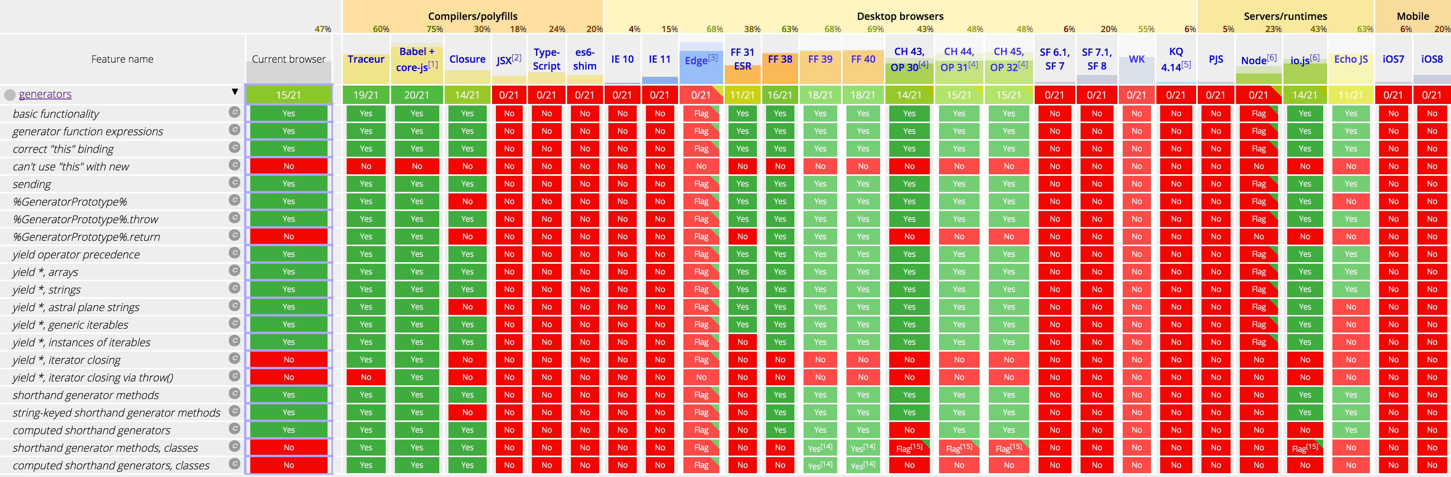
Using generators today
http://kangax.github.io/compat-table/es6/#generators
24
Notes:
Generators have to be transpiled for ES5 compatibility, as generators are a language feature, not just a function like Promise that can be shimmed.

Slide 25

Connecting The Dots
Promises + Generators =
https://imgflip.com/memetemplate/33059110/hell-yeah
25
Notes:
Why am I implementing async runner? What am I solving?
- Write async code with a sync look and feel to it, and making try catch work for async code.

Slide 26
Demo
26

Slide 27
Summary
From callback hell to nice synchronous looking code
Standardised API for dealing with async code
Prevent accidental sync code mixed with async
Can wrap multiple async functions in single try/catch
27
Notes:
OK, what have we learned?!

Slide 28
From
To
function getLastCustomerOrder(customerId, doneCallback, errorCallback){
try {
getCustomer(customerId, function(customer) {
try {
getCustomerOrders(customer, function(customerOrders){
doneCallback(customerOrders.slice().pop());
});
} catch(e) {
errorCallback(e);
}
});
} catch(e) {
errorCallback(e);
}
}
getLastCustomerOrder(1337, function(order) {
/*Do something fun with order */
}, handleError);
function *generator(customerId) {
try{
var customer = yield getCustomer(customerId);
var customerOrders = yield getCustomerOrders(customer);
var lastOrder = customerOrders.slice().pop();
/*Do something fun with order */
} catch(e) {
handleError(e)
}
}
asyncRunner(generator, 1337);
28

Slide 29
The Future Is Bright In ES7
function *doSomethingWithLastOrderGenerator(customerId) {
try{
var customer = yield getCustomer(customerId);
var customerOrders = yield getCustomerOrders(customer);
var lastOrder = customerOrders.slice().pop();
/*Do something fun with order */
} catch(e) {
handleError(e)
}
}
asyncRunner(doSomethingWithLastOrderGenerator, 1337);
async function doSomethingWithLastOrder(customerId) {
try{
var customer = await getCustomer(customerId);
var customerOrders = await getCustomerOrders(customer);
var lastOrder = customerOrders.slice().pop();
/*Do something fun with order */
} catch(e) {
handleError(e)
}
}
doSomethingWithLastOrder(1337);
http://jakearchibald.com/2014/es7-async-functions/
29

Slide 30
Thanks :)
https://github.com/paulinfrancis (code & slides)
You Don't Know JS: Async & Performance (book)
ES6 In Depth: Generators (Mozilla)
http://davidwalsh.name/es6-generators
30

